Slide 1
STREAMING MAP DEMO
Problems faced and how we rebuilt it
A short retrospective on replicating map-streamer behavior and turning it into a reliable architecture.
Notes:
[Sources]
- README.md
- projects/com.saab.map-streamer/ARCHITECTURE.md
[/Sources]

Slide 2
Three obstacles blocked a reliable starting point
REMOTE MAP The native HTTP loader was opaque and the distant CDN made runtime loading unreliable.
TIGHT COUPLING Map loading, traversal, building, rendering and shutdown lived in monolithic classes.
RISKY LOCKING Manual edit/render transitions could leave streaming locked after an error.
2
Notes:
[Sources]
- README.md
- projects/com.saab.map-streamer/ARCHITECTURE.md
- com.saab.map-streamer/Runtime/StreamingCore/StreamingPipeline.cs
[/Sources]

Slide 3
Streaming also needed safe reuse and bounded work
STALE REUSE Queued work could reach a pooled GameObject after it had been reassigned.
FRAME SPIKES Terrain, meshes and assets could not all be constructed in one frame.
CALLBACK CHURN Rapid load, unload and visibility events could replay obsolete state.
3
Notes:
[Sources]
- com.saab.map-streamer/Runtime/MapStreamer/Nodes/Pooling/NodeHandlePool.cs
- com.saab.map-streamer/Runtime/MapStreamer/Building/Coordination/NodeBuildCoordinator.cs
- com.saab.map-streamer/Runtime/StreamingCore/DynamicLoadCoordinator.cs
[/Sources]

Slide 4
We replicated and rebuilt upstream in three phases
PHASE 1
PHASE 2
PHASE 3
Establish the baseline
Run upstream unchanged, reproduce the remote-map failure, and trace the monolithic runtime from scene startup to rendering.
Rebuild map delivery
Download the complete tree, decode its URLs, deserialize and reserialize nodes for local paths, then package the result on GitHub.
Refactor and harden
Extract services, add dependency injection, formalize locking, version pooled objects, budget builds, and verify the new boundaries with tests.
4
Notes:
[Sources]
- README.md
- Download_Offline_Map.bat
- projects/com.saab.map-streamer/Packages/manifest.json
[/Sources]

Slide 5
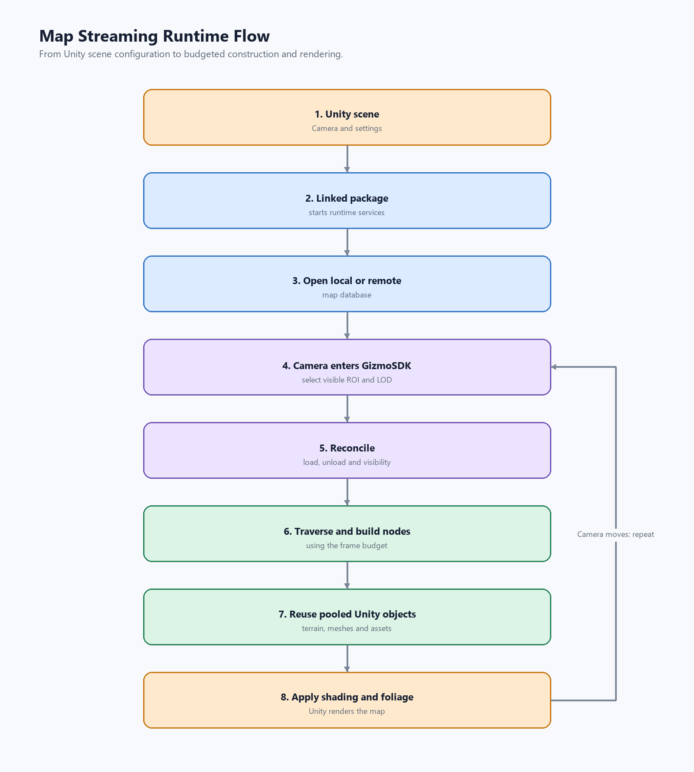
A controlled streaming pipeline
What changed
Offline delivery removed the runtime network dependency. Dependency injection exposed ownership. A lock state machine protected recovery. Versioned pooling rejected stale work. Budgeted queues kept construction responsive.
5
Notes:
[Sources]
- projects/com.saab.map-streamer/ARCHITECTURE.md
- Presentation/map-streaming-runtime-flow.png
[/Sources]

Slide 6
RESULT
The project became flexible and extensible
Predictable offline setup
Explicit lifecycle ownership
Safe, budgeted streaming
Notes:
[Sources]
- projects/com.saab.map-streamer/ARCHITECTURE.md
[/Sources]

